Slide 1

Which Programming Languages will still Exist in 2030?

Slide 2
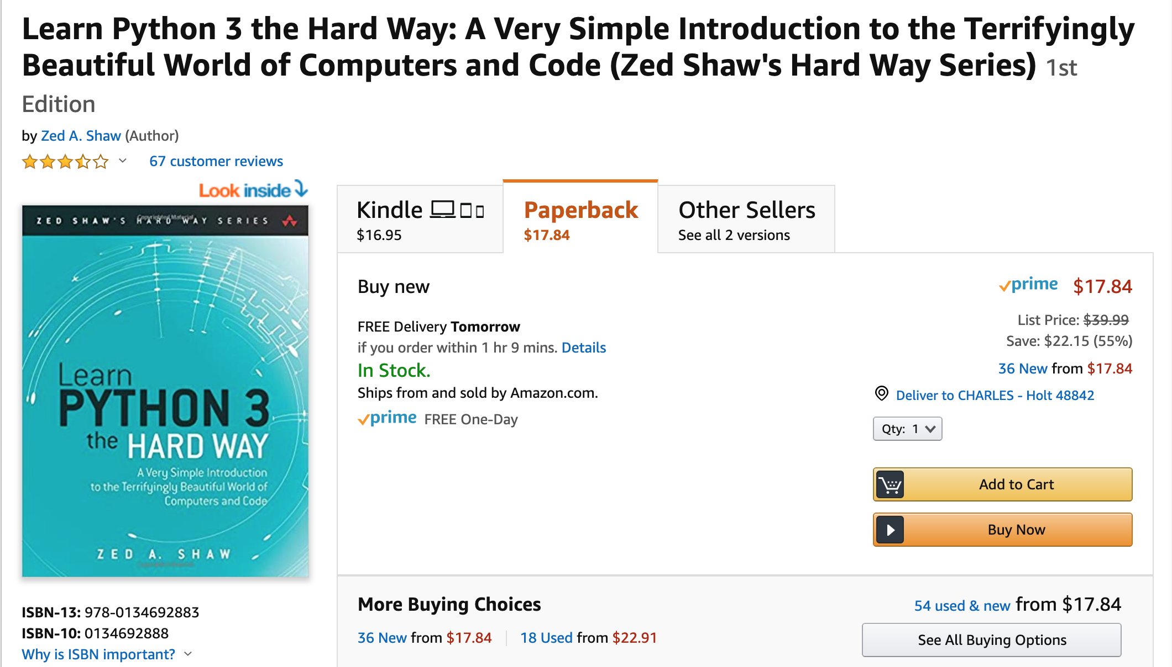

Slide 3
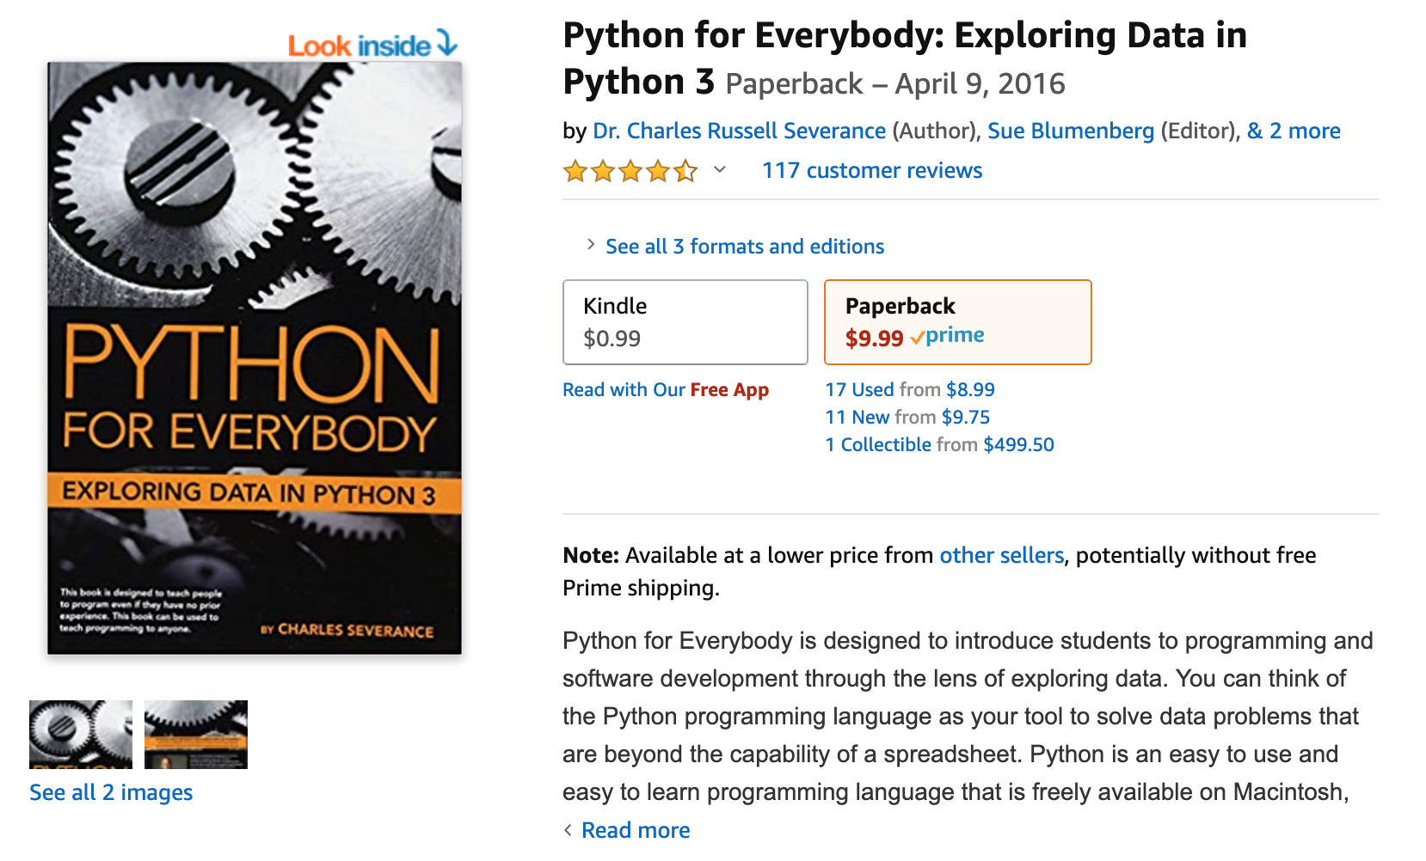

Slide 4
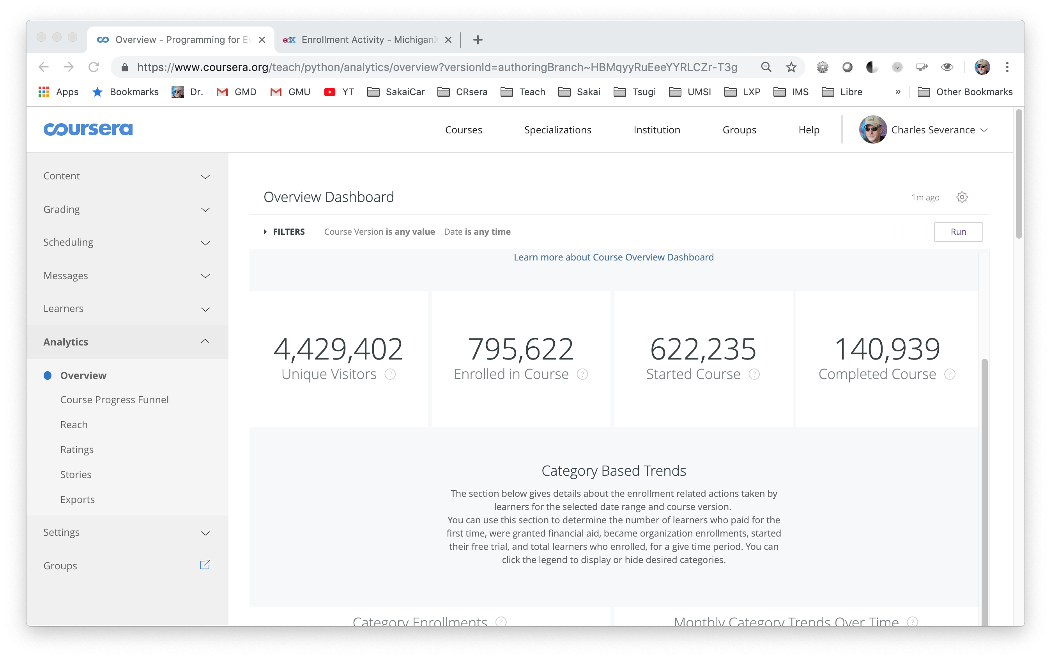

Slide 5
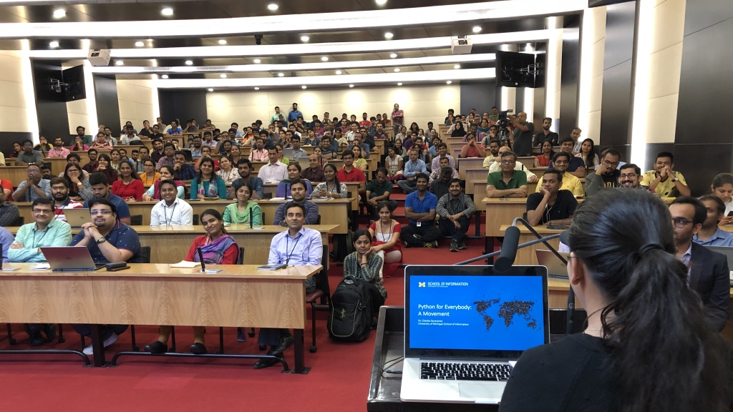

Slide 6
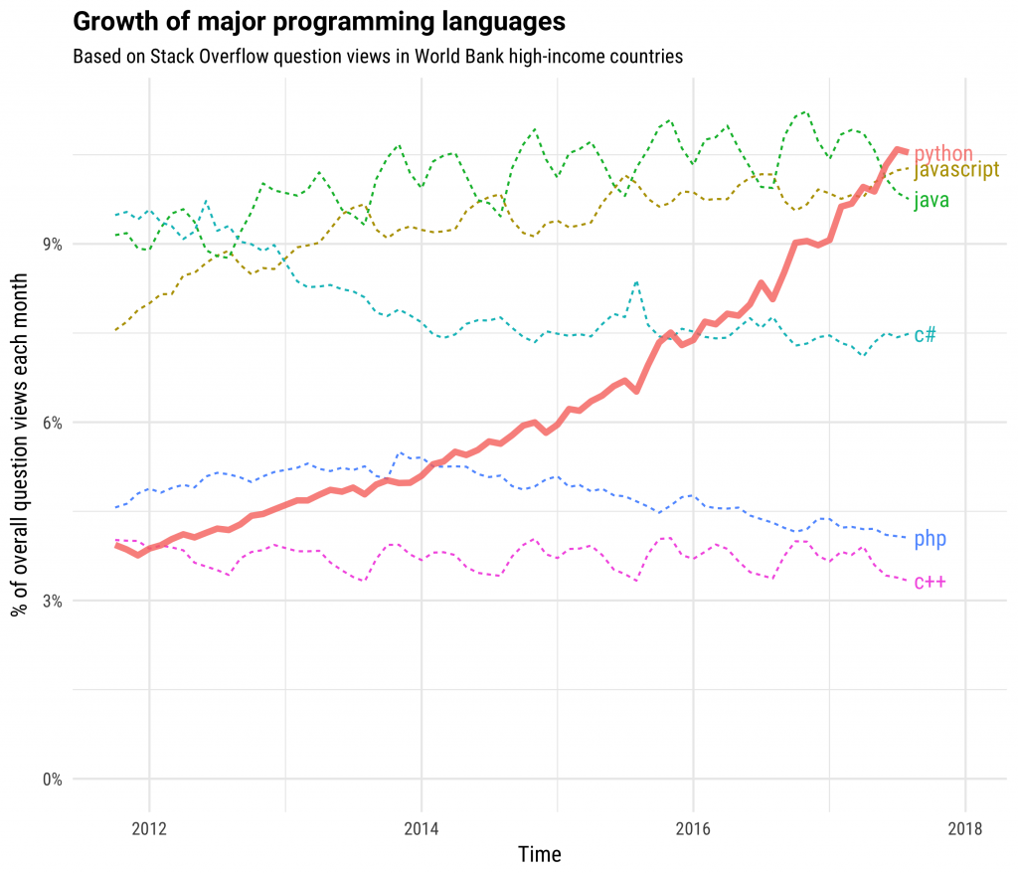

https://stackoverflow.blog/2017/09/06/incredible-growth-python/

Slide 7
Why Python?
The core of Python is small and easy to understand
Python is easily expanded using C when performance is critical
Python absorbs applications and turns them into libraries
Python loves orchestration
Statistics
Computation
AI / ML
Data Mining
Web Apps
????

Slide 8
Language Comparison
Language | Python | PHP | JavaScript | Java | C#
Linear | List / Tuple | Associative Array | Array | List<T> / Array | List<T>
Key / Value | Dictionary | Associative Array / Object | Object | Map<K,V> | Dictionary<TKey,TValue>
Packaging | Simple | Simple | Mishmash | Maven
Java int (primitive) versus Integer (object)
PHP – arrays are primitives
Ease of plugging in powerful "native" / C extensions to Python (PHP too)
Java / C# - data structure shape must be pre-agreed all the way down
….

